Slide 1

ONLINE VOTING SYSTEM
Group Members Student ID
SARVESH BHARTU - 23106055
KAUSTUBH BHOIR - 23106066
VARUN BURA - 23106129
ATHANG JADHAV - 23106039
Project Guide
Ms. TARUNA SHARMA

Slide 2
Outline
Introduction
Literature Survey
Problem Statement
System Design
Technologies and Methodologies
Implementation Screenshots(Partial )
Conclusion
References

Slide 3
Introduction
The points to be covered under Introduction chapter
Online voting software is one such solution, offering an efficient and secure way to conduct elections for various groups and organizations. This software allows voters to cast their ballots from anywhere with an internet connection, removing the need for physical polling stations.
Motivation: It makes voting more accessible, especially for people who find it difficult to get to polling places. It also saves time and resources and ensures that votes are counted accurately and transparently. This leads to a more democratic process where everyone’s voice can be heard.
Objectives: online voting system aims to make it easier and more efficient for citizens to participate in elections.

Slide 4
Literature Survey
NAME AND TOPIC | YEAR | DESCRIPTION
J. R. B. Wright : "Cryptographic Solutions for Secure Online Voting". Security and Privacy in Online Voting Systems. | 2018 | Wright's 2018 paper on cryptographic solutions for online voting highlights crucial security measures like end-to-end encryption, though practical implementation may be complex and resource-intensive.
V. P. Sharma : "Bridging the Digital Divide: Ensuring Inclusivity in Online Voting Systems". Accessibility and Inclusivity in Online Voting. | 2020 | Sharma's 2020 paper on online voting emphasizes improving accessibility and inclusivity, focusing on addressing digital divides and recommending solutions while noting challenges in infrastructure and training.

Slide 5
Literature Survey
NAME AND TOPIC | YEAR | DESCRIPTION
S. K. Patel : "Leveraging Blockchain and AI for Enhanced Online Voting Security". Technological Innovations and System Design. | 2021 | Patel's 2021 paper explores how blockchain and AI can enhance the security and efficiency of online voting systems, though practical deployment may encounter challenges with technology adoption and integration.
R. S. Kumar : "Implementing Online Voting Systems: Challenges and Feasibility". Implementation Challenges and Feasibility. | 2020
Kumar’s work examines the practical aspects of implementing online voting systems, including regulatory, technical, and operational challenges.

Slide 6
Problem statement
Ensuring the security and integrity of online voting systems to prevent hacking, tampering, and fraud.
Making online voting accessible to all eligible voters, including those with disabilities and in remote locations.
Developing a clear legal and regulatory framework to govern online voting and resolve disputes.
Fostering public trust through transparency and reliable verification processes.

Slide 7
System Design
User Authentication Module: Authenticates users and verifies eligibility, interacting with the database for credential checks.
Voting Process Module: Facilitates vote casting and ensures accurate recording updating the database server.
Security Module: Maintains data integrity and prevents unauthorized access, collaborating with all modules for secure data handling.
Database Module: Manages storage of user information, votes, and logs using relational databases, interacting with the application server for data retrieval and updates.
Reporting and Analytics Module: Generates reports and analyzes voting patterns, accessing data from the database.

Slide 8
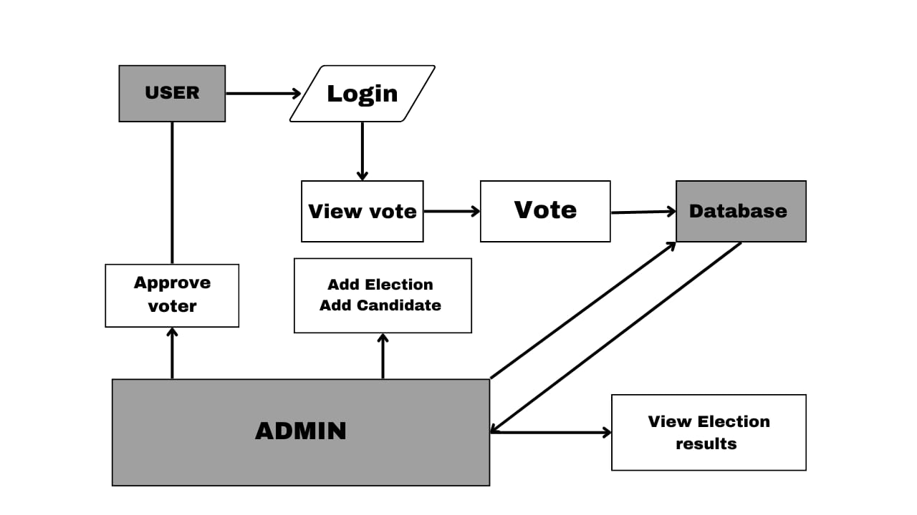

Slide 9
Technologies and Methodologies
Platforms and Technologies
Front-End: Web-based UI using frameworks like CSS and HTML.
Back-End: Server-side logic implemented using javascript.
Database: Firebase for database management

Slide 10
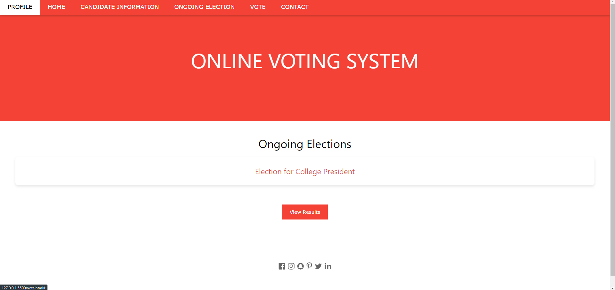
Implementation

Slide 11
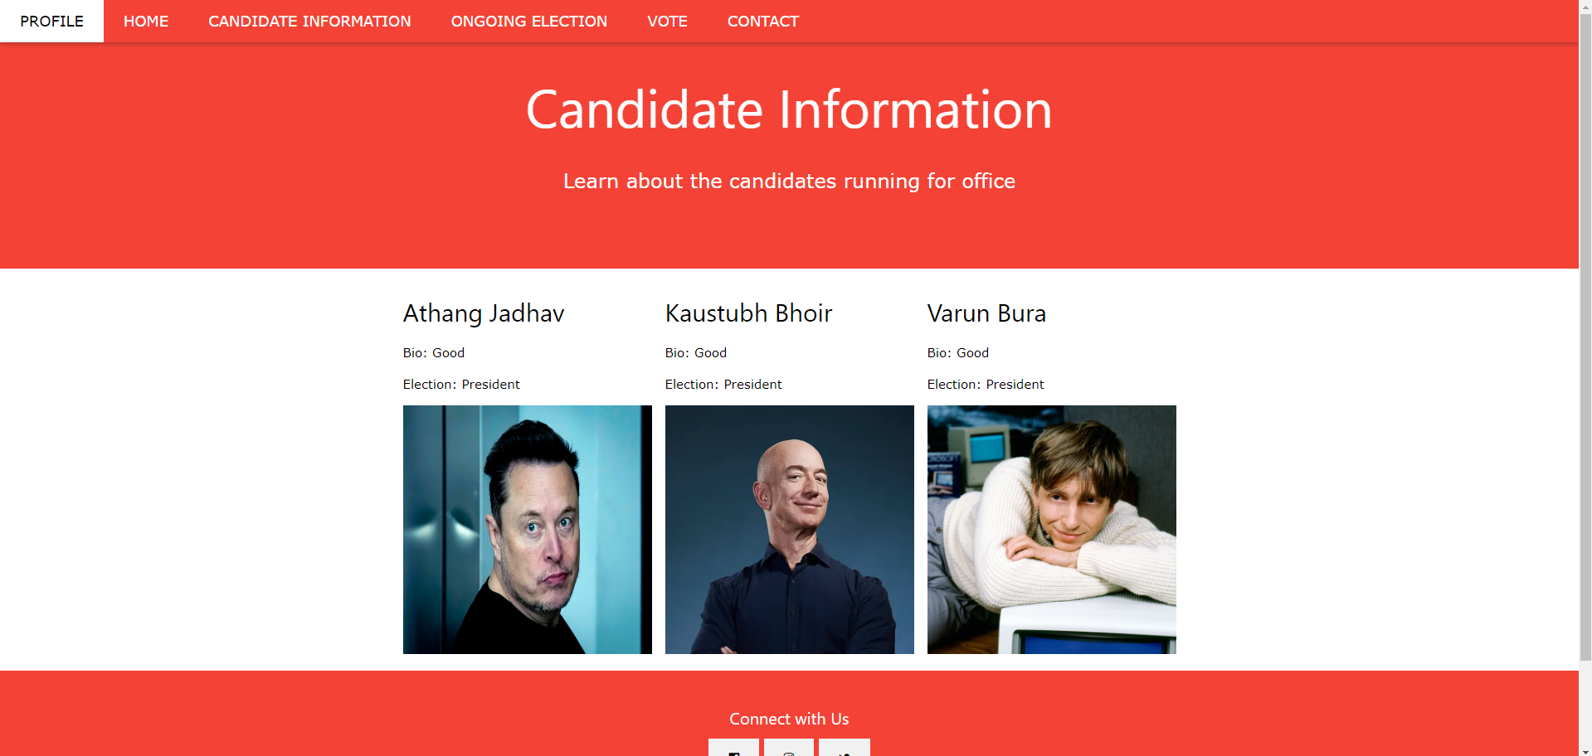

Slide 12
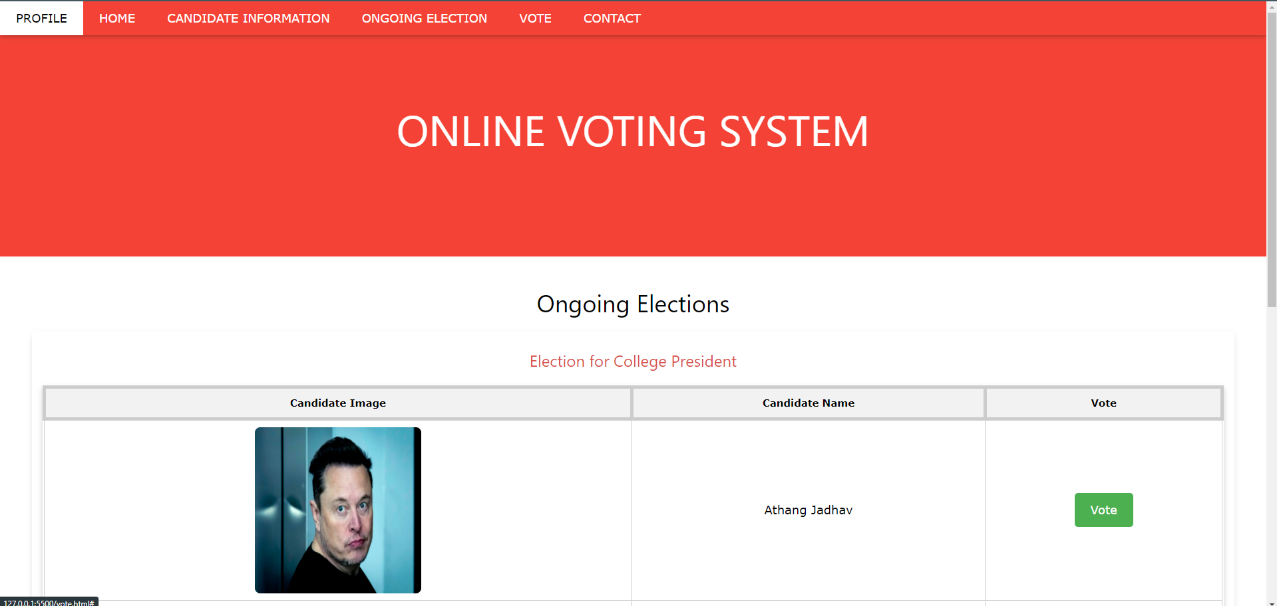

Slide 13


Slide 14
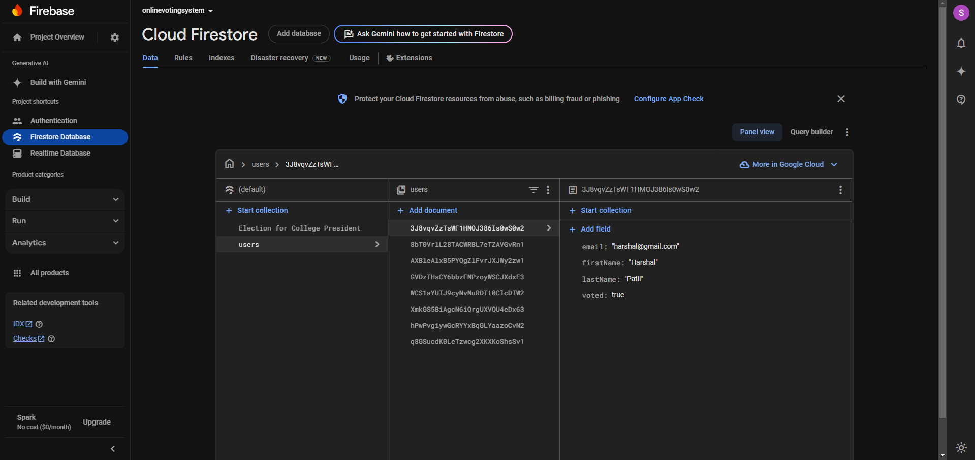

Slide 15
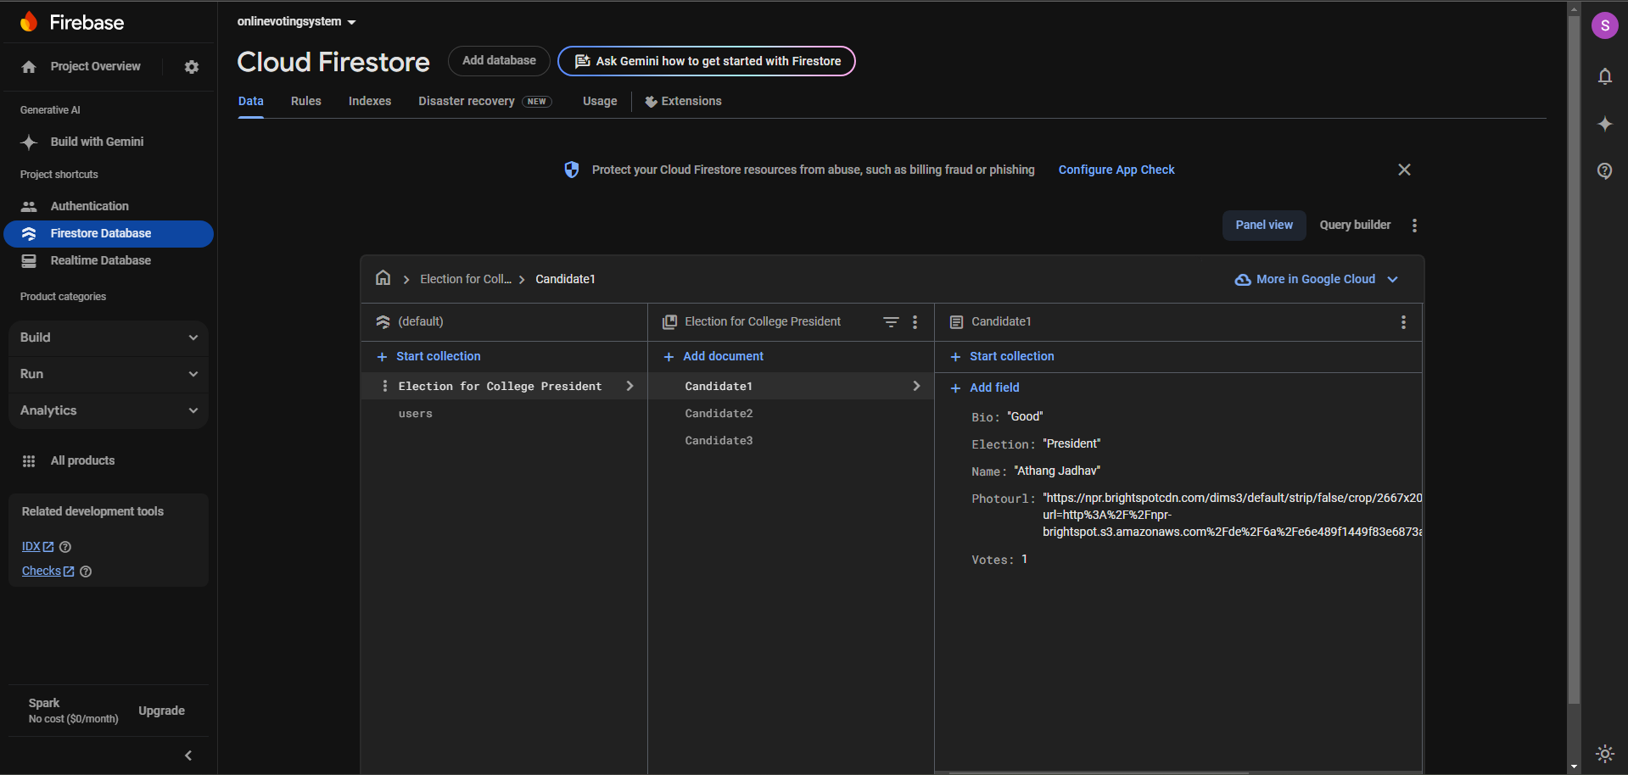

Slide 16
Conclusion
The Online Voting System represents a significant advancement over traditional voting methods, streamlining the process and conserving resources. It promises increased transparency and accountability through secure authentication and verification. Nonetheless, challenges related to security, privacy, and accessibility must be addressed before public deployment. To fully realize its potential, it's crucial to build a robust security framework and ensure the system is accessible to all voters, ultimately fostering a more inclusive and democratic electoral process.

Slide 17
References
[1] J. R. B. Wright , "Cryptographic Solutions for Secure Online Voting".
Research Focus: Security and Privacy in Online Voting Systems.
[2] V. P. Sharma , "Bridging the Digital Divide: Ensuring Inclusivity in Online Voting
Systems".
Research Focus: Accessibility and Inclusivity in Online Voting.
[3] S. K. Patel , "Leveraging Blockchain and AI for Enhanced Online Voting Security".
Research Focus: Technological Innovations and System Design.
[4] R. S. Kumar , "Implementing Online Voting Systems: Challenges and Feasibility".
Research Focus: Implementation Challenges and Feasibility.

Slide 18
Thank You...!!

